Slide 1
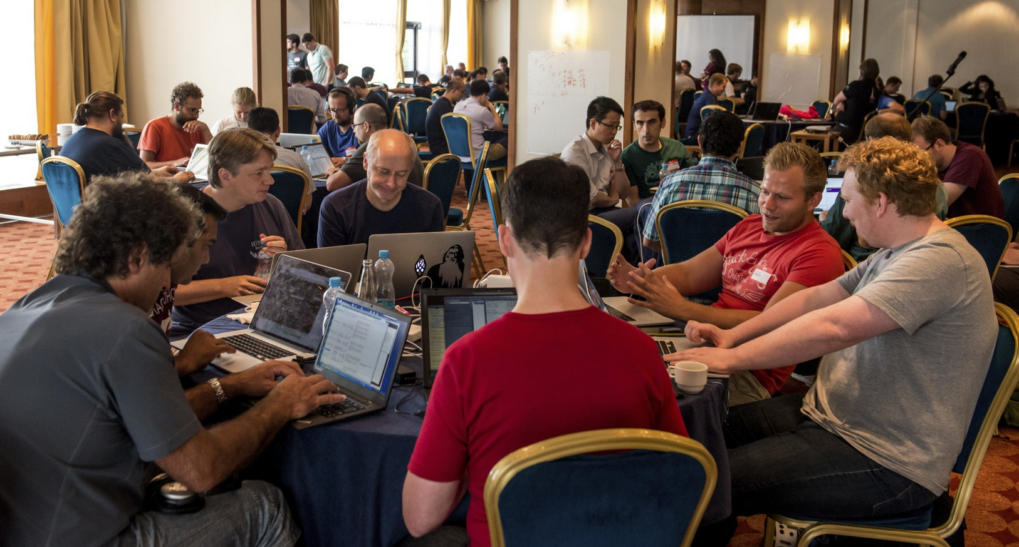
IETF Hackathon
IETF 99, July 15-16
Prague, Czech Republic

Slide 2

Agenda - Sunday
09:00: Room opens - Pastries and coffee provided
12:30: Lunch provided
13:30: Hacking stops, prepare brief presentation of project
14:00: Project presentation to other participants and judges
15:00: Recap and suggestions for improvements
15:30: Awards presented, praise and thanks given
16:00: Hackathon ends
17:00: Tear down complete

Slide 3
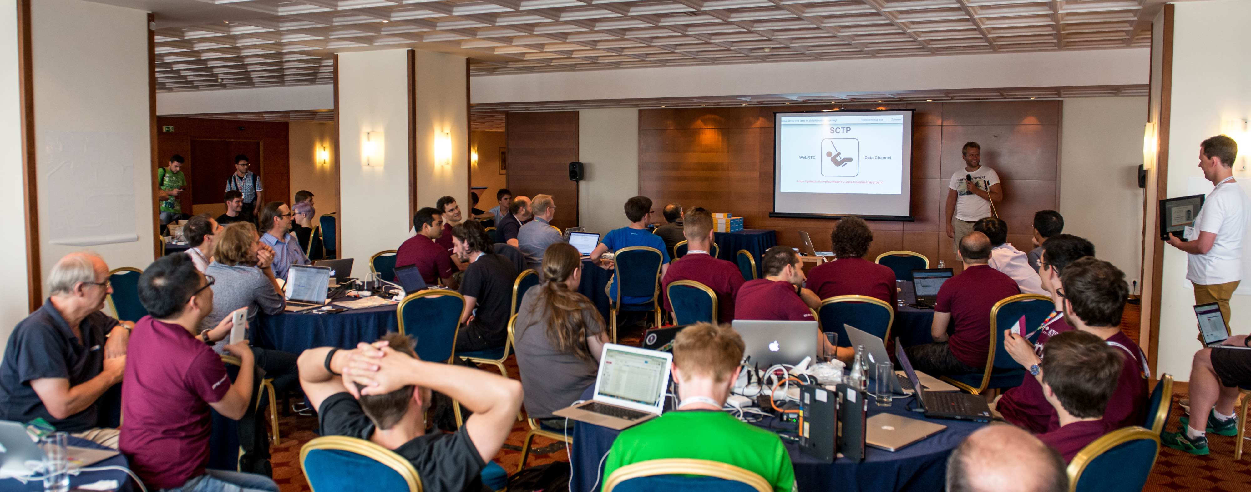
Project Presentations
What problem are you solving?
How you plan to solve it?
What did you achieve?
Things to highlight
Lessons learned
Feedback to work group
First time IETFers
3 minute time limit

Slide 4
Project List
Authenticated Received Chain (ARC)
HTTP error code 451
SDN Apps for management of microwave radio link via IETF YANG Data Model
DNS, DNSSEC, DNS Privacy
YANG/NETCONF/RESTCONF
SACM
RIOT
OpenWSN
SCHC implementation and test
QUIC
Interface to Network Security Functions (I2NSF) Framework
Loss-Latency tradeoff
ACME STAR
TCPINC
SCTP
NEAT/TAPS
DOTS
Multiple Provisioning Domains (mPvD) and Captive Portal detection
COSE in the network: Secure Wake-on-Radio (SWORN)
SysRepo - Segment Routing v6
MILE
Secure IoT bootstrapping for Noobs with EAP-NOOB
MPTCP
Multicast over SPRING

Slide 5
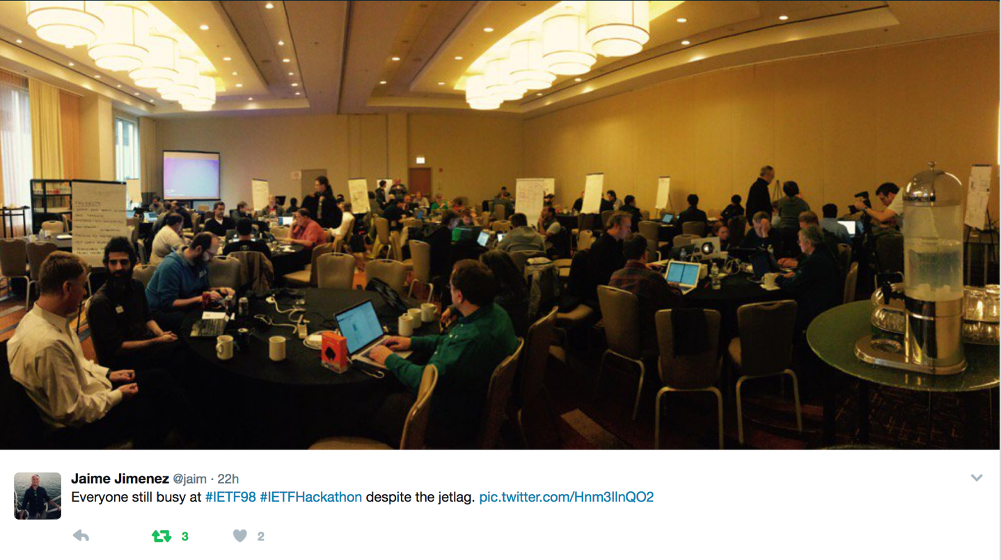
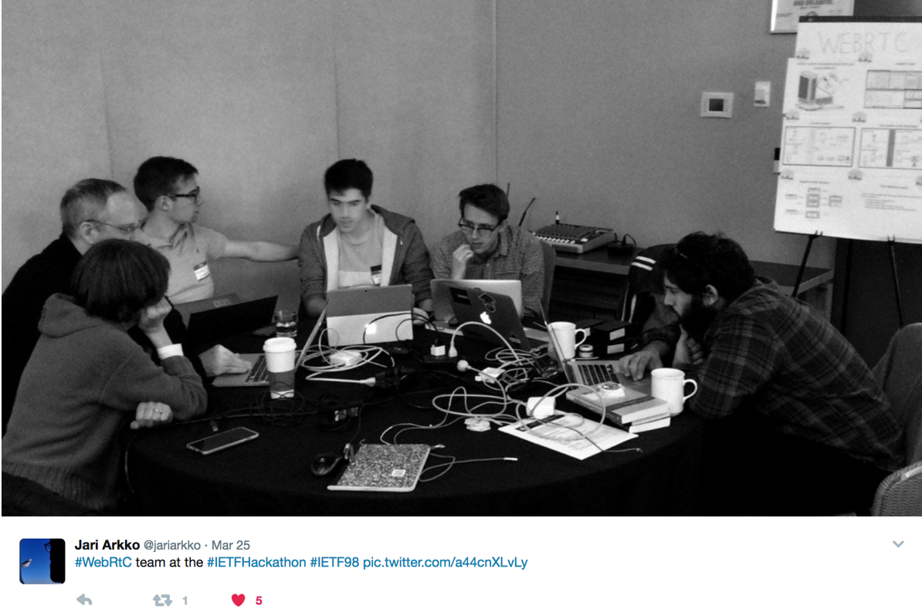
#IETFHackathon Photo Contest
Best IETF Hackathon Photo
Post to Twitter
#IETFHackathon
#IETF99

Slide 6

THANK YOU!

